Slide 1
HEALTH BENEFITS ADVISOR
MEDICAL AND DENTAL BRIEF
Naval Medical Administrative Unit and Branch Dental Clinic Monterey
Officer In Charge: LCDR Tamora Holland Department Head: TBD Senior Enlisted Leader: HMC Renzon Lajarde
Health Benefits Advisor: Mr. Joseph Maniulit
Guarding the Health of the Fleet

Slide 2
HEALTH BENEFITS ADVISOR
MEDICAL AND DENTAL BRIEF
HEALTH BENEFITS ADVISOR (HBA)
HBA: Joseph Maniulit
Location: NPS, Hermann Hall, Student Services Office. Room 038-E
Hours of Operation: Monday to Friday at 0800-1200; Lunch 1200-1300; 1300-1600
Phone number: 831-656-3807 & Email: joseph.maniulit.civ@health.mil
FUNCTIONS / JOB SCOPE:
Advise International Students and their family of their medical benefits
Liaison/Advisor for IMS, IMS Program Managers, NETSAFA, Presidio of Monterey Army Health Clinic and VA Gourley Clinic for Dependents, In-network clinics, TRICARE, and can assist IMS with other health insurance or country embassy with medical coverage issues
Provide list of medical resources available to IMS
Enrolls IMS and family to MHS Genesis, provides and processes medical reimbursement claims to (NETSAFA, TRICARE, or IMS), and provides support and information on medical referrals for IMS and family members
Guarding the Health of the Fleet

Slide 3
HEALTH BENEFITS ADVISOR MEDICAL AND DENTAL BRIEF
CHECK IN PROCESS WITH HBA
**International Military Student Check-in**
1. Bring a copy of your ITO
2. Must have your DOD ID Card (Must be enrolled in DEERS prior to appointment)
***E-mail, Call, or Walk in to schedule an appointment***
3. Health Benefits Advisor Location: NPS, Herman Hall, Student Services Office, Room 038-E
4. Hours of Operation: Monday to Friday at 0800-1200; Lunch 1200- 1300; 1300-1600
**International Military Student’s Dependents (family members)**
1. Bring ITO or amended ITO
2. Provide family’s Foreign Identification number if waiting for DOD ID card appointment
3. DOD ID Card (Must be enrolled in DEERS prior to appointment )
**Telephone Check-in: Call 831-656-3807 and ensure to provide the HBA the same information, DOD ID card number, and family’s DOD ID # or FIN

Slide 4
HEALTH BENEFITS ADVISOR
MEDICAL AND DENTAL BRIEF
Types of Medical Care
Routine Care: Primary Care Clinic
1. Presidio of Monterey Army Health Clinic. Primary Military Medical Treatment Facility is only for active-duty personnel. Services provided are appointment with Primary Care Provider for routine exams (physical exams), any non-emergent or non-urgent medical care (annual checkup). Other available services if applicable Pharmacy, laboratory, and X-ray. Make an appointment with Primary Care Physician, call 1-(800) 404-4506
2. VA Gourley Family Practice and Pediatric Clinic for family members.
1-800-404-4506 ***Ask Agent to do a Warm-Transfer to the Gourley Clinic***
Urgent Care: Civilian Urgent Care Clinics (walk-ins available for IMS and family members)
1. Requires medical attention on the same day basis (but is not consider a true emergency). If your primary care physician doesn’t have available appointments for that day or no appointment availabilities within a week. Types of not emergent symptoms ( fever, vomiting, abdominal pain, musculoskeletal pain, or ear pain. Use Urgent Care Facility (walk in based services). Go to Urgent Care Clinic of your choice, if there’s no available appointments at Army Health Clinic for the IMS and VA/Gourley Family Practice or Pediatrician Clinic, if both Primary Clinics are close.
Emergency Care: (walk-ins available for IMS and family care). Imminent threat to life, limb, eyesight chest pains, coughing or vomiting blood, suicidal or homicidal thoughts. Use nearest emergency room (Walk in based services).
Guarding the Health of the Fleet

Slide 5
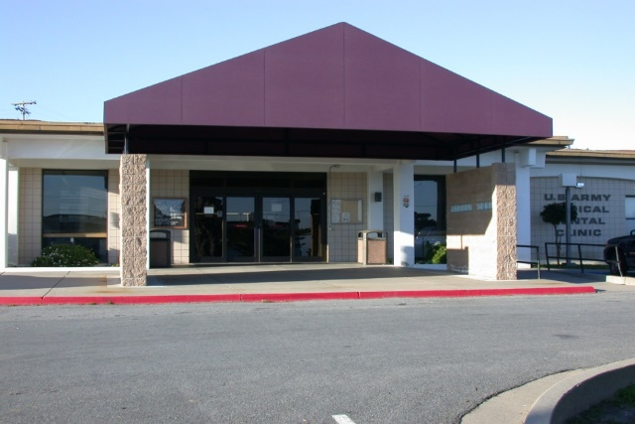
HEALTH BENEFITS ADVISOR
MEDICAL AND DENTAL BRIEF
Presidio of Monterey Army Health Clinic
Location:473 Cabrillo Street, Bldg. 422, Presidio of Monterey
Clinic hours 0700-1600
Third Thursday of the month 0700-1030
For appointment call: 1-800-404-4506
***Primary Care for Active Duty**
Available Services for Dependents: Pharmacy (if in stock)
Medical Care: Based on space availability
After hours non-emergency care (For Enrolled Patients Only)
Nurse Advise line: 1-800-404-4506, select option 4 (available 24/7)
Appointments are offered based on the urgency of your medical need
Please bring your DOD ID card and have your FIN# available for your appointment
Guarding the Health of the Fleet

Slide 6
HEALTH BENEFITS ADVISOR
MEDICAL AND DENTAL BRIEF
VA / Gourley DOD Medical Clinic
***Primary Care for Family Members / Pediatric Clinic***
Primary Place of care for International Military Students Dependents
Primary Military Medical Treatment Facility is only for family members of the IMS. Services provided are appointment with Primary Care Provider for routine exams (physical, required school medical exams, and sports physical exams), any non-emergent or non-urgent medical care (annual checkup).
Location: 201 9th Street, 3rd Floor, Marina, CA 93933
Clinic hours: Mon- Fri 0800-1630, Close for lunch 1230-1330
Third Thursday of the Month 0800-1030
Appointment Line Phone #: 1-800-404-4506 ***Ask to be warm-Transferred to the VA Gourley Clinic***
***Available for all foreign military dependent family members on your ITO***
Guarding the Health of the Fleet

Slide 7
HEALTH BENEFITS ADVISOR
MEDICAL AND DENTAL BRIEF
Pregnancy Insurance Requirements
Foreign military/ foreign civilians and their family members are qualified for pregnancy insurance coverage within 60 days of arrival to the United States or during the open enrollment period usually November 15 – January 15
Pregnancy insurance must include coverage of pre and post natal care, as well as delivery, of at least $250,000 (this is in addition to the $400,000 minimum coverage for basic medical insurance)
If medical costs are paid by your country, country will be notified of impending pregnancy through official channels
Unless ITO specifically states foreign government or FMS case will pay all costs related to that pregnancy and delivery, spouses who are pregnant prior to departure for Monterey must present proof of complete pregnancy coverage prior to being authorized as an accompanying dependent on the ITO
Guarding the Health of the Fleet

Slide 8
HEALTH BENEFITS ADVISOR
MEDICAL AND DENTAL BRIEF
Medical Facilities Off Limits for Routine Care
Foreign military or their dependents are not allowed to seek care for pregnancy or routine visit at the Travis Airforce base unless referred by the Presidio of Monterey Army Health Clinic.
Foreign Military or their dependents are not allowed to get the care at the Seaside Public Health Center.
Guarding the Health of the Fleet

Slide 9
HEALTH BENEFITS ADVISOR
MEDICAL AND DENTAL BRIEF
Emergency
Call –911 For emergency care (threat to life, limbs, eyesight), members should go to the closest available Emergency Room, which for the Monterey Peninsula is the Community Hospital of the Monterey Peninsula (CHOMP) 831-624-5311
Guarding the Health of the Fleet

Slide 10
HEALTH BENEFITS ADVISOR MEDICAL AND DENTAL BRIEF
QUESTIONS OR CONCERNS CONTACT HBA
Contact via email address
If you have questions regarding your medical benefits,
If you receive a referral from the military treatment facility to a civilian doctor
You went to an emergency room or urgent care center
You receive a bill from civilian provider, laboratory or pharmacy

Slide 11
HEALTH BENEFITS ADVISOR
MEDICAL AND DENTAL BRIEF
Questions
Guarding the Health of the Fleet

