Slide 1
Naval Postgraduate School
Laser Safety Training
Scott Giles
NPS Laser System Safety Officer (LSSO)
Research Safety Department Safety Engineer
831-656-7568
Updated 18AUG2020

Slide 2
Purpose
The purpose of this training is to equip you with the information you need to safely use lasers in support of research and training at NPS
This training fulfills the mandatory training requirements for use of Class 3B and 4 lasers as prescribed by OPNAVINST 5100.27B, ANSI Z136.(series), and NPSINST 5100.27B

Slide 3
Overview
NPS Laser Safety training is not trivial. You will be expected to be proficient with the Laser Safety information presented and apply that knowledge in your future Laser encounters. I recommend you carve out a time and place conducive to absorbing a couple hours of important safety information
It consists of 6 modules and approximately 123 slides. Each module takes about 10-20 minutes to review depending on experience with Laser Safety. The Modules are:
  Laser Fundamentals
  Terms, Definitions, and a Description of the Nominal Hazard Zone
  Biohazards
  Laser Classification, Control measures, and Accident Summaries
  Eye and Skin Protection and Medical Surveillance
  Laser Authorization and Approval, Lab and Range Requirements
You must pass the Quiz to work on lasers at NPS: If you are taking this training for the first time, there is a multiple choice quiz that follows the training. Passing score on the quiz is 75%. The quiz emphasizes the practical aspects of laser fundamentals and laser safety. All answers are in this Training. The quiz is on Sakai. You must be added to that site and take the quiz there.

Slide 4
Module One
Laser Fundamentals

Slide 5
Introduction to Lasers
A Laser is a device that emits light (electromagnetic radiation) through a process of optical amplification based on the stimulated emission of photons. The term "laser" originated as an acronym for Light Amplification by Stimulated Emission of Radiation.
L
ight
mplification by
timulated
mission of
adiation
A
S
E
R

Slide 6
Properties of Light
Color of light is determined by Wavelength of the emission.
  Shorter wavelengths tend to the violet (400nm) and ultraviolet end of the spectrum (higher energy photons)
  Longer wavelengths tend to the red (700nm) and infrared end of the spectrum (lower energy photons)

Slide 7
Properties of Light
The energy of a photon, E, is determined by its frequency, ν, and Planck’s constant, h (6.626 x 10⁻³⁴ J•s)
E = h ν
The velocity of light in a vacuum is
c = 3 x 10⁸ m/s
The wavelength, λ, and frequency, ν, are related as
c = λ ν
Notes:
Note that as wavelength decreases, frequency increases, and as the frequency increases, the energy increases.

Slide 8
Laser Theory and Operation
Photon energy
Q1 - Q0 = hν
When high energy electrons in high orbitals of an atom move to lower energy orbitals, it produces electromagnetic energy
Q1
Q0
Nucleus
Orbitals
Q1 = higher energy state
Q0 = lower energy state
Notes:
This occurs every time an electron drops from a higher energy state (Q1) to a a lower energy state (Q₀) in an atom or ion like in a fluorescent light. This also happens from changes in vibrational or rotational state of molecules.

Slide 9
Population Inversion
A population inversion occurs when a system (such as a group of atoms or molecules) exists in a state with more members in an excited state than in lower energy states.
The concept is of fundamental importance in laser science because the production of a population inversion is a necessary step in the production of laser light.

Slide 10
Population Inversion
Population inversion = larger electron population in an excited state than ground state.
Without something to pump up more high energy electrons, this state decays back to lower energy state.
Decay occurs in two ways
  spontaneous decay
  stimulated decay
Notes:
Population inversion is an unstable state for the electrons. They will stay in this state for a short time, then decay back to their original state. This decay occurs in 2 ways, spontaneous decay and stimulated decay.

Slide 11
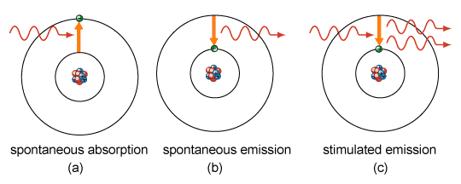
Decay
Spontaneous Decay and emission
  electrons fall to ground state while emitting randomly directed photons
Stimulated Decay and emission
  A correctly energized photon can strike electrons, causing them to return to their ground state and release another photon - of the same energy, and direction, and phase.
Notes:
Spontaneous decay – electrons fall to ground state while emitting randomly directed photons
Stimulated decay – photons from spontaneously decaying electrons strike other electrons, causing them to fall to their ground state. This stimulated transition will release energy in the form of photons of light that travel in phase with the same wavelength and in the same direction as the incident photon. If the direction is parallel to the optical axis, the emitted photons travel back and forth in the optical cavity through the lasing material between the totally and partially reflecting mirrors. The light energy is amplified in this manner until sufficient energy is built up for laser light to be transmitted through the partially reflecting mirror.

Slide 12
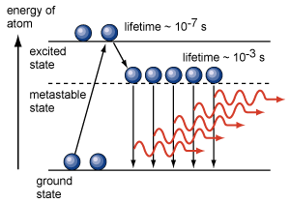
Energy Levels
Notes:
A lasing medium must have at least one excited (metastable) state where electrons can be trapped long enough (microseconds to msec) for a population inversion to occur and not immediately and spontaneously drop to lower states. Although laser action is possible with only 2 energy levels, most lasers have 4 or more levels.

Slide 13
Components of a
Laser
Lasing Material or Medium
  crystal, gas, semiconductor, dye, etc.
Pump
  adds energy to the lasing medium, e.g., flashlamp, electrical current to cause electron collisions, radiation from another laser, etc.
Optical Cavity
  reflectors to provide a feedback mechanism for light amplification and stimulation

Slide 14
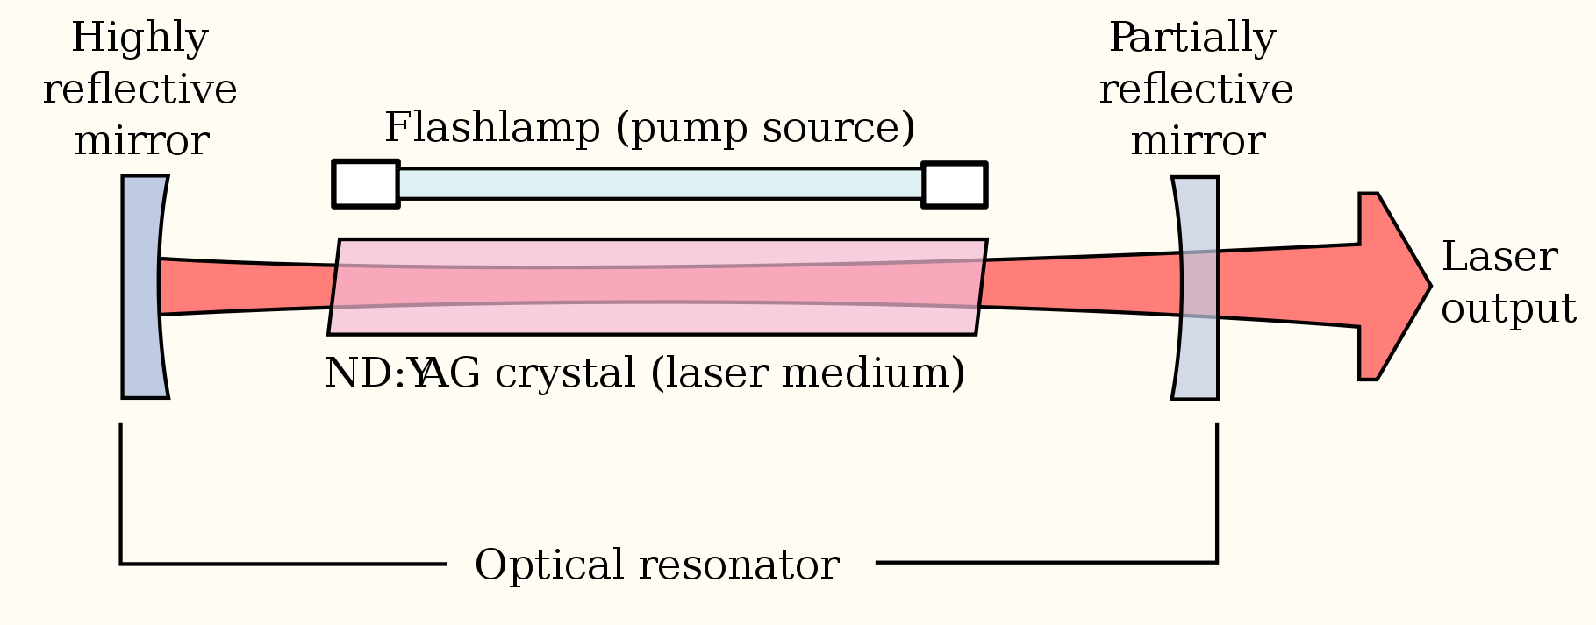
Basic Laser Operation
Pump
Simple optical cavity laser
Notes:
When enough photons are traveling in the preferred direction, some will punch through the partially reflecting mirror and the rest are reflected back to continue the process. The photons are now of the same wavelength and are in phase. A coherent, collimated beam is the result.

Slide 15
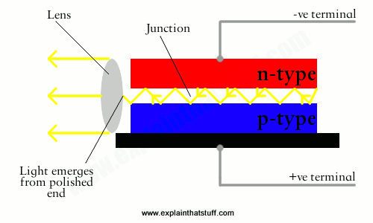
Diode Example
Population inversion at the pn-junction occurs when a voltage is applied.
Under favorable conditions, stimulated emissions result
Material properties can provide an optical cavity that capture and collimate
Applications can be tiny

Slide 16
Laser Types
Lasing Material
  Gas
  Crystal
  Dye
  Semiconductor
  Free Electron
Optical Cavity
  Single crystal (Fabry–Pérot)
  Simple
  Trapezoidalish (OPO)
Temporal Properties
  Continuous Wave
  Pulsed
    Single-pulsed
    Repetitively-pulsed

Slide 17
Beam Characteristics
Wavelength
Beam divergence
Beam profile (i.e. Gaussian, square wave, etc.)
Beam diameter
Energy and Power
Continuous Wave or
Pulsed
  Pulse width (sometimes called length or duration)
  Pulse repetition frequency (PRF)
  Pulse trains

Slide 18
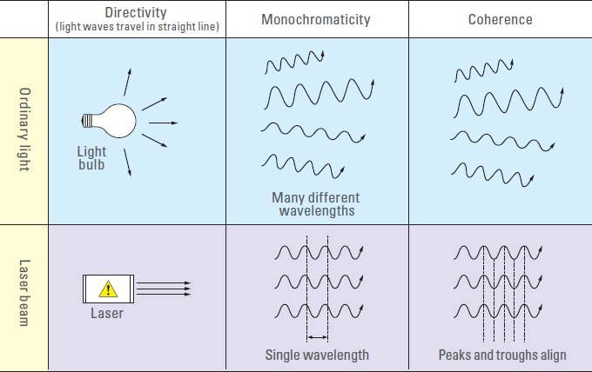
Lasers vs Conventional Lights
Laser beam
  Coherent
  Monochromatic
  Collimated
  Focused
Lightbulb
  Incoherent
  Multispectral
  No “Beam” – Light is random and divergent
  Diffuse

Slide 19
Lasers vs Conventional Lights
The eye is the most sensitive part of the body to damage from most types of lasers. These primarily include visible and near infrared lasers.
But why are lasers typically more hazardous than conventional lights?

Slide 20
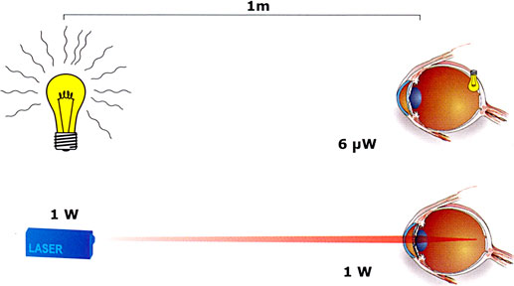
Lasers vs Conventional Lights
This shows how the light from a conventional light source is focused by the eye to form an extended image on the retina; whereas laser light is focused onto a very small spot (approximately 2 to 20 μm) on the retina.

Slide 21
Lasers vs Conventional Lights
This focusing effect makes the eye more sensitive to laser radiation than any other part of the body. And more sensitive to laser irradiance, than the irradiance of other objects.
When viewing a point source of light such as a laser (or distant star), the energy/area is greatly amplified when focused onto the retina. The optical gain of the eye (the ratio of corneal to retinal irradiance) for a point source is approximately 100,000 times in the 400-1400 nm (retinal hazard zone) range.

Slide 22
Two Hazard Types
Beam Hazards
  Usually an eye hazard
  Can be a skin hazard (UV and CO₂ lasers)
Non Beam Hazards
  Chemical:
    Laser Generated Air Contaminants (LGAC)
    Compressed Gases: Helium, CO, CO₂, Nitrogen, etc.
  Biological
    Infectious Disease from LGAC (medical lasers)
  Physical:
    Electric Shock
    Plasma Radiation (Typically requires very high beam irradiance e.g laser welding or cutting)

Slide 23
Beam Hazards
Irradiance: W/cm^2 (per steradian)
Typical Irradiances on the retina:
TV set: 10⁻⁶ W/cm²-sr
Incandescent Lightbulb: 10⁻³ W/cm²-sr
Welders Arc: 10 W/cm²-sr
The Sun (Bright Day): 10 W/cm²-sr
1 mW laser pointer: 100 W/cm²-sr
Retinal Irradiance: A 1 mW laser pointer is 10 times brighter on your retina than the Sun and can damage the retina!

Slide 24
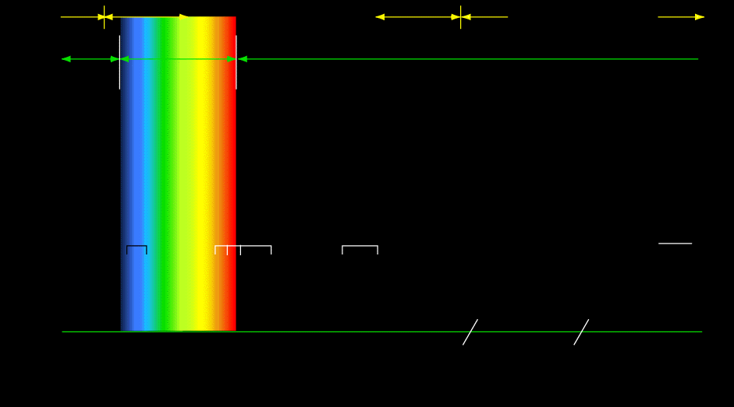
Laser Spectrum
CORNEAL EYE DAMAGE
RETINAL EYE DAMAGE
CORNEAL EYE DAMAGE
ULTRA-VIOLET
VISIBLE
INFRARED
DOUBLE
NEODYMIUM
HELIUM
NEON
GALLIUM
ARSENIDE
XENON
CHLORIDE
XENON
FLOURIDE
ARGON
PINK
RUBY
ALEXANDRITE
RED
RUBY
NEODYMIUM
YAG
HELIUM
NEON
ERBIUM
HELIUM
NEON
CARBON
DIOXIDE
NITROGEN
GAS
1064nm
1118nm
1207nm
1540nm
3300nm
10600nm
308nm
488nm
514nm
532nm
633nm
694nm
700nm
704nm
830nm
870nm
nm 300 400 500 600 700 800 900 1000 1100 1200 1300 1400 3000 4000 9000 10000
Å 3000 4000 5000 6000 7000 8000 9000 10000 11000 12000 13000 14000 30000 40000 90000 100000
μm 0.3 0.4 0.5 0.6 0.7 0.8 0.9 1.0 1.1 1.2 1.3 1.4 3.0 4.0 9.0 10.00

Slide 25
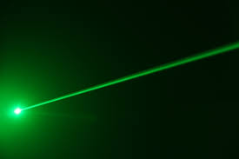
Continuous Wave Lasers
Beam is continuous unless chopped
Beam on > 0.25 s
Measured in watts
Maximum power is the same as the average power

Slide 26
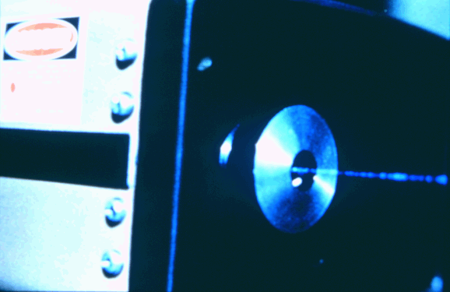
Pulsed Lasers
Beam pulsed < 0.25 s
  Defined by pulse width (time) and PRF (freq)
Typically measured in Energy (Joules/pulse)
Instantaneous power increases as pulse gets shorter
Nanosecond (10⁻⁹ s) pulses are common
10⁻¹⁸ s (attosecond) pulses are possible
Notes:
Mode locked laser – A laser that functions by modulating the energy content of each mode internally to give rise selectively to energy bursts of high peak power and short duration. A laser in which many resonant modes are coupled in phase to yield a train of very short pulses.

Slide 27
Laser Propagation in a Medium
As a Gaussian laser beam propagates through a medium such as air or water, it produces a profile as shown (exaggerated). It expands or “diverges” in space.

Slide 28
Beam Diameter vs. Range
Beam Diameter, D_{L}, of a Gaussian laser beam is a function of range, r, from the exit port or beam waist of the laser and can be calculated as
where a is the beam diameter and φ is the beam divergence (1/e).
As the beam diameter spreads, the energy per/area decreases. The irradiance decreases.
At some distance (r), the diameter will be large enough, and the irradiance will be safe.

Slide 29
Atmospheric Effects
As electromagnetic radiation such as light propagates through the atmosphere or any material medium, its intensity is attenuated by absorption and scattering. After propagating a distance, r, through the atmosphere, intensity, I, is given by
where I₀ is the initial intensity and μ is the atmospheric attenuation coefficient. This can be significant over kilometers at outdoor ranges, but is usually ignored in the laboratory.
Notes:
The units of μ must be the inverse of those of r. That is, if r is represented in cm, them μ must be represented in cm⁻¹ so that the term μr is dimensionless. The equation shows how intensity falls off exponentially as a function of distance from the laser source.

Slide 30
Light Interaction w/Materials
Materials can
  reflect light (e.g., mirrors)
  transmit light (e.g., windows)
  absorb light (e.g., tinted windows)

Slide 31
Reflections
Specular
  Mirror-like reflection
  Surface imperfections much smaller than (<1/10th) the wavelength of the incident optical radiation
  Essentially equivalent power densities to the beam itself
Diffuse
  Surface irregularities randomly oriented and significantly larger than λ
  Results in significantly reduced irradiance (power/area) because scattering results in up to 1/r (2D) or 1/r² (3D) reduction in irradiance (r = distance from diffuse reflection)
Intermediate
  Some blend between a perfect reflection and full scattering.

Slide 32
Reflection and Transmission Coefficients
If light is incident on an interface separating two transmitting media (e.g., air/glass), some is reflected, some is transmitted, and some is absorbed.
Where T ,R, and A are the transmission and reflection coefficients:
T + R + A = 1.
Coefficients depend on material properties, the wavelength of the radiation, the angle of incidence, and potentially the polarization.
If no energy is absorbed, then T+R=1, and the material is theoretically unaffected by the energy

Slide 33
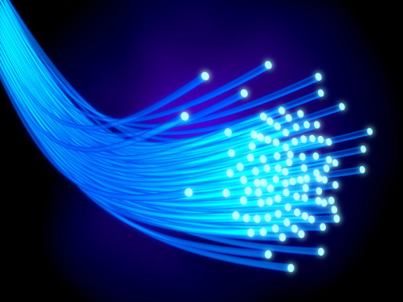

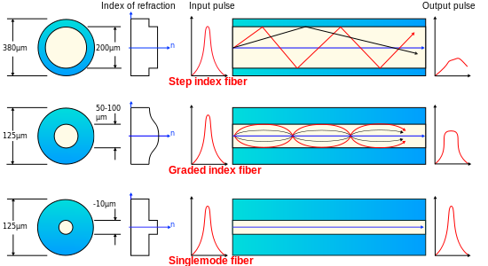
Fiber Optics
Common to capture a diode laser output, refocus it into a fiber optic
Diameter matters
A temporal signal can be transferred very accurately, or energy can be spread
Watch for cracks, kinks, and loose fibers
"Optical fiber types" by Mrzeon - self-made, based on Image:Tipos_fibra.jpg. Licensed under CC BY-SA 3.0 via Commons - https://commons.wikimedia.org/wiki/File:Optical_fiber_types.svg#/media/File:Optical_fiber_types.svg

Slide 34
Module Two
Terms, Definitions, and a Description of the Nominal Hazard Zone

Slide 35
Definitions
Laser Systems Safety Officer (LSSO) – The officer who is trained, certified, and designated by the command to conduct the command’s laser safety program. Generally each command has one LSSO.
Range Laser Safety Officer (RLSO) – A person, qualified at least as a Technical Laser Safety Officer, who is also designated by the command to perform the functions of a Range Laser Safety for outdoor use of lasers.
Designated Laser Custodian – A permitted and trained NPS faculty, staff, student, or contractor who has been authorized to possess, use, and supervise other trained designated laser workers in the use of command approved class 3B or 4 lasers.
Designated Laser Worker – A member of the NPS faculty, staff, or student who has been trained in general laser safety and is authorized to receive system specific training and use class 3B and 4 lasers under the permit, and authority of a Laser Custodian.

Slide 36
Definitions
Continuous Wave (CW) laser. A laser operating with a continuous output for a period of ≥ 0.25 seconds.
Pulsed Laser. A laser which delivers its energy in the form of a single pulse or a train of pulses. The duration of a pulse is < 0.25 s.
Repetitively Pulsed Laser (RPL). A laser with multiple pulses of radiant energy occurring in a sequence. The pulse repetition frequency must be ≥ 1 Pulse/sec for a laser to be considered “pulsed”

Slide 37
Definitions
Power. Energy per unit time Unit: watt (W)
Irradiance. Radiant power incident per unit area upon a surface. Unit: watt per square centimeter (W/cm²).
Radiant energy (Q). Energy emitted, transferred, or received as radiation. Unit: joule (J).
Radiant exposure (H). Surface density of the radiant energy received. Unit: joules per square centimeter (J/cm²).

Slide 38
Definitions
Maximum Permissible Exposure (MPE). Def: The level of laser irradiation or radiant exposure to which a person may be exposed without hazardous effect or adverse biological changes in the eye or skin.
Note that this is a property of the biology of the eye or skin and varies with wavelength and exposure time. It is a biological limit, and not dependent on the power of the laser involved in the exposure.
MPE is an important quantity. Typically specified in W/cm² for continuous wave events or J/cm² for pulsed events, it is a measure of power or energy “allowed” to enter the eye or hit an area of skin.
Again, MPE does not depend on laser power. But all else equal, a more powerful laser can more readily exceeded an MPE

Slide 39
Definitions
Accessible Emission Limit (AEL). The maximum accessible emission level permitted within a particular class of lasers. Unlike MPE from the previous slide this measure is used as a means to classify lasers, this property can vary considering the class the laser.
“For this laser, in this application, what is the maximum power [or radiant energy] that will still be Class X?”

Slide 40
Definitions
Nominal Ocular Hazard Distance (NOHD). The distance along the axis of the laser beam beyond which the MPE is not exceeded (referred to as r_{NOHD} in ANSI Z136.1).
Nominal Hazard Zone (NHZ). The NHZ describes the space (i.e. 3D volume) within which the level of the direct, reflected or scattered radiation during operation exceeds MPE. Exposure levels beyond the boundary of the NHZ are below the applicable MPE.

Slide 41
Nominal Hazard Zone Description
The three dimensional volume that contains the single dimensional NOHD applied in all feasible directions
When the NOHD is long (e.g. longer than the dimensions of the laser enclosure) and reflections are feasible, then the NHZ generally just becomes the physical barriers of the laser enclosure area or lab i.e. walls, ceilings, and floors
Inside the NHZ, personal protective equipment (PPE) such as eyewear is required
Outside the NHZ PPE is not required
NHZ required to be posted and controlled
The NHZ may be different for the eyes and skin and will generally just be specified as the most restrictive of the two

Slide 42
Definitions
Beam Diameter. The distance between diametrically opposed points in that cross-section of a laser beam where the irradiance is 1/e (0.368) times the peak irradiance (or radiant exposure for a pulsed laser).
Divergence. The increase in the diameter of the laser beam with distance from the exit aperture, based on the full angle at the point where the irradiance (or radiant exposure for pulsed lasers) is 1/e times the maximum value.

Slide 43
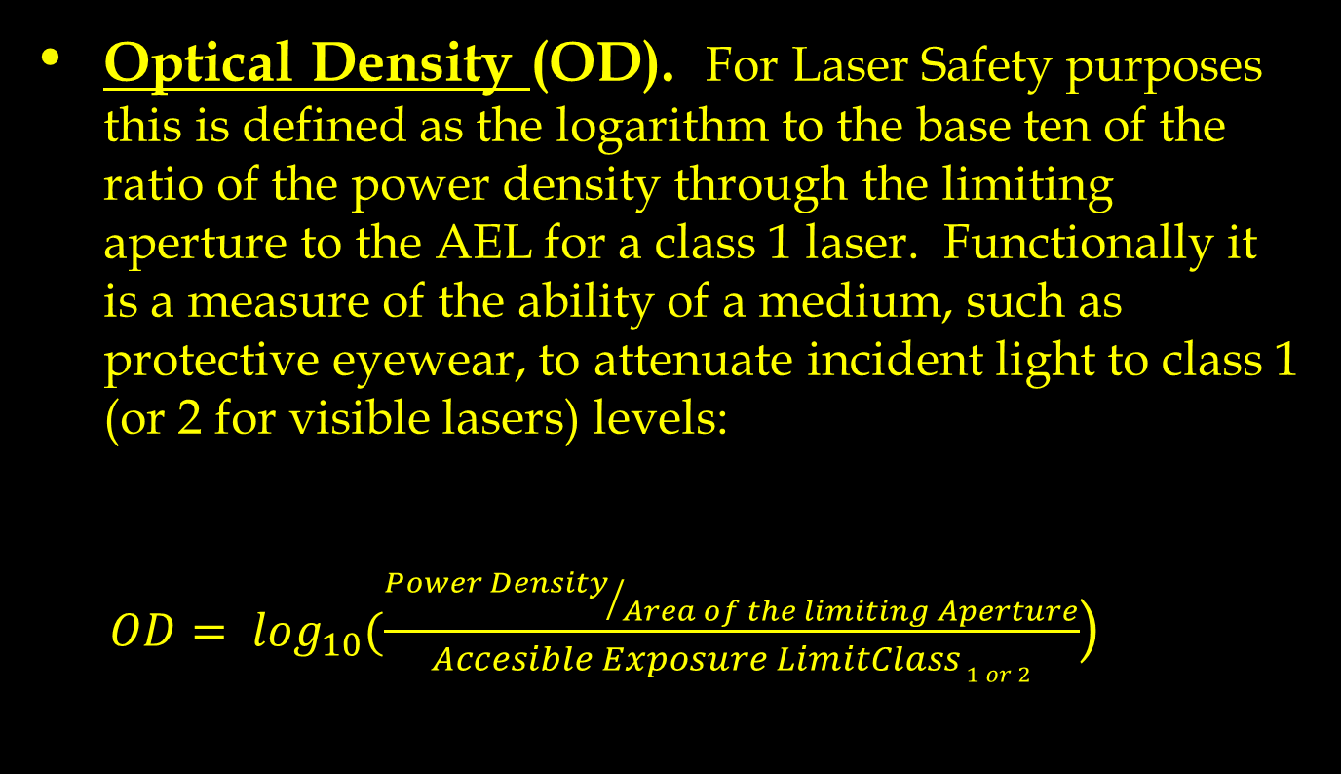
Definitions
Optical Density (OD). For Laser Safety purposes this is defined as the logarithm to the base ten of the ratio of the power density through the limiting aperture to the AEL for a class 1 laser. Functionally it is a measure of the ability of a medium, such as protective eyewear, to attenuate incident light to class 1 (or 2 for visible lasers) levels:
    $OD= \log_{10}(\frac{{Power Density}/{Area of the limiting Aperture}}{Accesible Exposure LimitClass 1 or 2}$)

Slide 44
Module Three
Biohazards

Slide 45
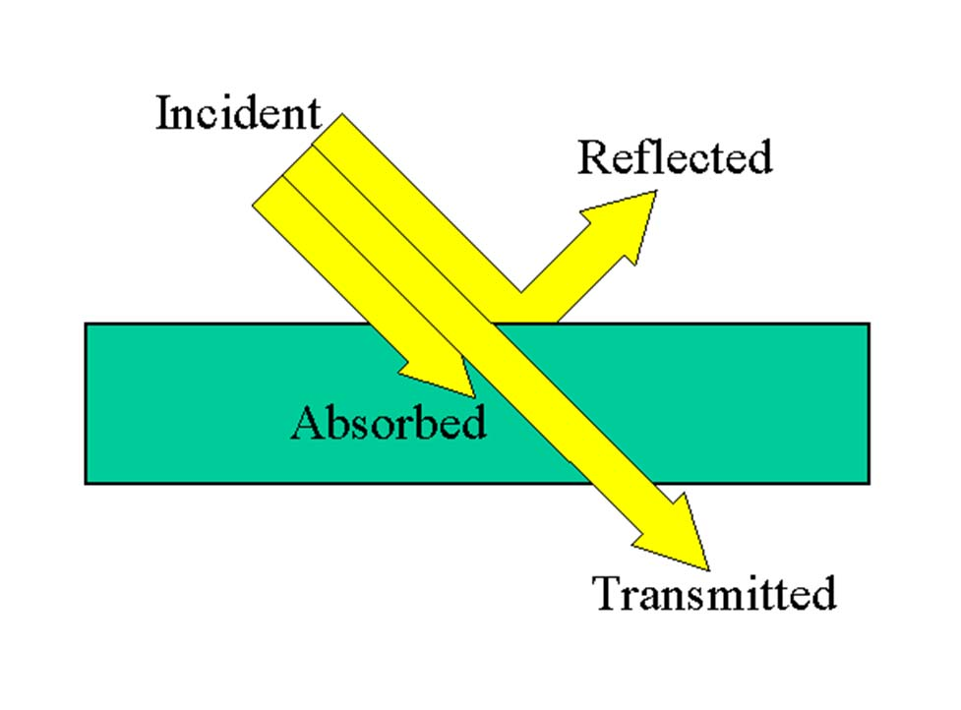
First Law of Photobiology
Specific tissues will either absorb or transmit energy
Energy must be absorbed to do damage
Transmitted wavelengths do no damage

Slide 46
Biological Effects
Laser radiation absorbed by the skin penetrates only a few layers.
In the eye, visible and near infrared (400-1400 nm) radiation passes through the cornea, and is focused on and absorbed by the retina. This is the “Retinal Hazard Zone”. Note that it contains some non-visible wavelengths.
It is the wavelength of the light that determines the visible sensation of color: violet at 400 nm, red at 700 nm, and the other colors of the visible spectrum in between.

Slide 47
Laser Spectrum
CORNEAL EYE DAMAGE
RETINAL EYE DAMAGE
CORNEAL EYE DAMAGE
ULTRA-VIOLET
VISIBLE
INFRARED
DOUBLE
NEODYMIUM
HELIUM
NEON
GALLIUM
ARSENIDE
XENON
CHLORIDE
XENON
FLOURIDE
ARGON
PINK
RUBY
ALEXANDRITE
RED
RUBY
NEODYMIUM
YAG
HELIUM
NEON
ERBIUM
HELIUM
NEON
CARBON
DIOXIDE
NITROGEN
GAS
1064nm
1118nm
1207nm
1540nm
3300nm
10600nm
308nm
488nm
514nm
532nm
633nm
694nm
700nm
704nm
830nm
870nm
nm 300 400 500 600 700 800 900 1000 1100 1200 1300 1400 3000 4000 9000 10000
Å 3000 4000 5000 6000 7000 8000 9000 10000 11000 12000 13000 14000 30000 40000 90000 100000
μm 0.3 0.4 0.5 0.6 0.7 0.8 0.9 1.0 1.1 1.2 1.3 1.4 3.0 4.0 9.0 10.00

Slide 48
Biological Effects
When radiation is absorbed, the effect on the absorbing biological tissue is either photochemical, thermal, or mechanical
  UV - primarily photochemical
  IR - the action is primarily thermal
  Visible - both photochemical and thermal effects are present
When the intensity of the radiation is sufficiently high, damage to the absorbing tissue will result by mechanical agitation.
Sufficiently strong radiation can lead to a “lesion”

Slide 49
Physiological Damage Mechanisms
The trauma sufficient to produce a lesion is followed by biological reactions within the tissue itself.
  protein mutations related to the radiant energy and direction of the exposure
  mechanical destruction - ripping or tearing of tissue caused by a thermo-acoustic transient pressure wave
Since the eye is made to collect and concentrate light on the retina, the eye is the organ most sensitive to visible and near IR laser radiation (400 to 1400 nm). If the eye will be safe at these wavelengths, the rest of the body will be safe.

Slide 50
Effects of Various Wavelengths

Slide 51
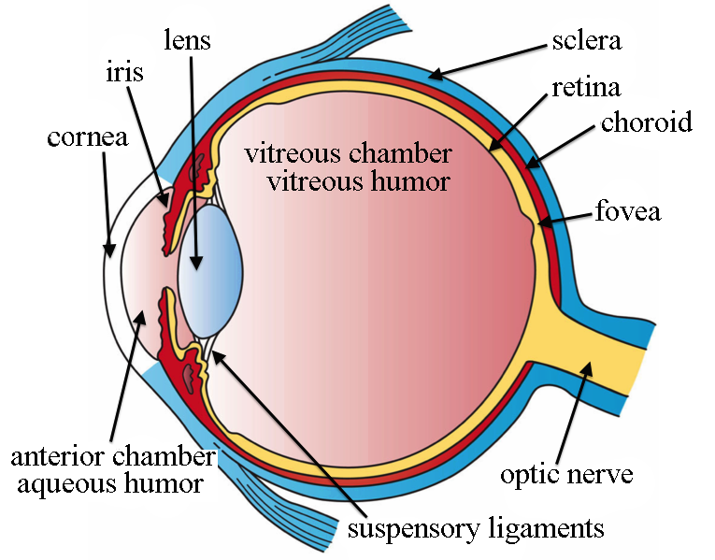
Pathway of Laser Light in the Eye
Cornea
  80% refraction
Aqueous Humor - water
Pupil
Lens
  100,000 fold increase in light on retina
Vitreous Humor
  jelly like substance
Retina

Slide 52
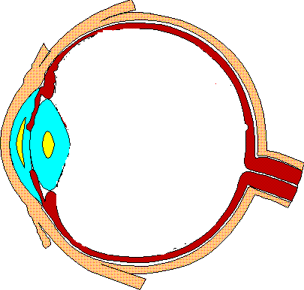
Path of Retinal Hazard Wavelengths in the Eye
LENS
CHOROID
IRIS/PUPIL
VITREOUS HUMOR
SCLERA
CORNEA
RETINA
FOVEA
AQUEOUS HUMOR
OPTIC DISK
OPTIC NERVE
CILIARY MUSCLE
Notes:
The cornea, the transparent bulge on the front of the eye, is the primary refracting structure of the eye. Because of the difference in refractive indexes of air and the cornea, 80-percent of the refraction of light takes place as light enters the eye. That is why corrective eye surgery is done on the cornea rather than attempting to reshape or replace the lens.
The lens is moveable/reshapeable by the ciliary muscles and serves as the dynamic focus for the eye.
The aqueous humor and vitreous humor allow for this movement and maintain the index of refraction through the eye.
The retina is the light-absorbing structure of the eye where the rods and cones (detectors/receptors) are. There is a high concentration of cone cells in a specialized region called the macula. In the center of this region, the cone cells are densely packed together in a small depression to produce an area of high sensitivity to visual detail and color discrimination. This area of less than 1 mm in diameter is called the fovea centralis and is our area of greatest visual acuity. When we focus our vision on an object or read, we focus the image on the fovea. Laser damage to the foveal area will have far greater effect on visual acuity than equivalent laser damage on the periphery of the retina. The natural blind spot is caused by the optic nerve and disk and is about 2.5 mm in diameter; visually, this blind spot goes unnoticed. Damage to the optic disk, however, is likely to result in a total loss of vision in that eye.
The other neural receptors (rod cells) are most sensitive to low light levels and are distributed over the entire retina except within the foveal area. This explains the sailor’s rule (method) for spotting a ship at night on the horizon or why you can see a star “out of the corner of your eye” by not looking directly at it, but if you look directly at the star, it disappears. This also better allows you to detect movements to the side in the dark.
The sclera is the dense fibrous white outer coat enclosing the eye (except in the area of the cornea) – it provides structure.
The choroid is the vascular membrane (carrying blood throughout the eye) containing large branched pigment cells between the retina and sclera.
The retinal pigment epithelium is the base of the retina – critical in retinal metabolism and photochemistry – this is where retinal detachment occurs.
The iris serves as the variable aperture for different light levels and changes in size in most persons when they lie or are attracted to someone.

Slide 53
Photobiology of the Eye
UV C
100-280 nm
UV B
280-320 nm
CORNEA
Photochemical
Effects
CORNEA
LENS
UV A
320-400 nm
VISIBLE
400-700 nm
IR A
700-1400 nm
RETINA
Thermal Effects
IR B
1500-1800 nm
ALL BUT RETINA
IR C
3000- 1,000,000 nm
CORNEA

Slide 54
Retinal Hazard Zone
Human eye hazard is greatest between 400-1400 nm
Focused by cornea and lens
Absorbed by the retina
Permanent damage to the retina is likely if exposed to laser radiation in excess of the maximum permissible exposure (MPE)
Note that the retina contains no nerve cells. Retinal damage can occur without a sensation of pain

Slide 55
Near IR
Radiation is absorbed through the volume of the eye between:
1500-1800 nm
Mostly absorbed in the cornea, lens, and through the Vitreous Humor
Fully absorbed before reaching the retina
Damage can occur at almost any absorption point
Notes:
Different parts still absorb differently!!

Slide 56
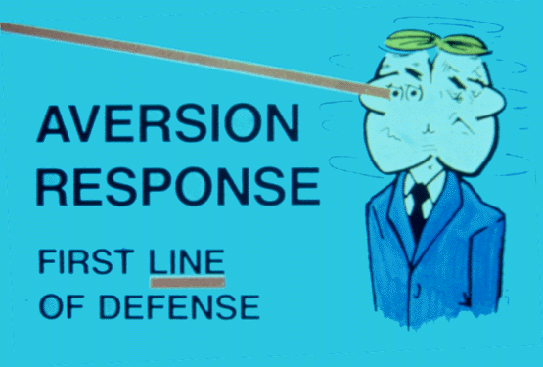
Aversion Response
Blink and turn head
About .25 sec
Works only with visible wavelengths (400-700 nm)
Protection afforded for visible Class 1 and Class 2 lasers.
Injury reduction potentially afforded for visible Class 3R and Class 3B lasers.

Slide 57
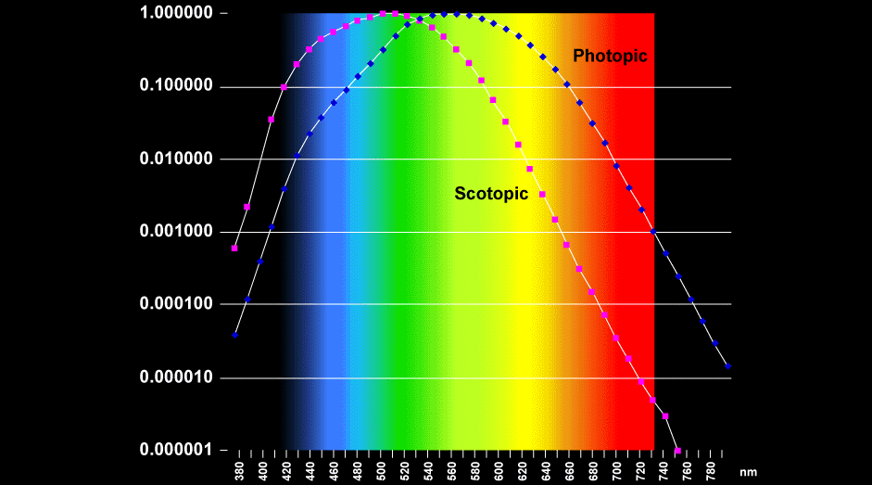
Spectral Sensitivity of Eye
Note: According to this graph, a green laser pointer appears brighter than a red one.
(Photopic = Cones)
Notes:
Contrast this with transmission.

Slide 58
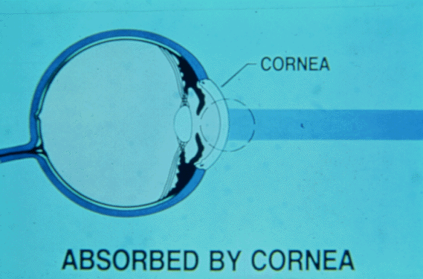
UV-B, UV-C, and IR-C: Corneal Damage
100-320 nm or 1800-1,000,000 nm

Slide 59
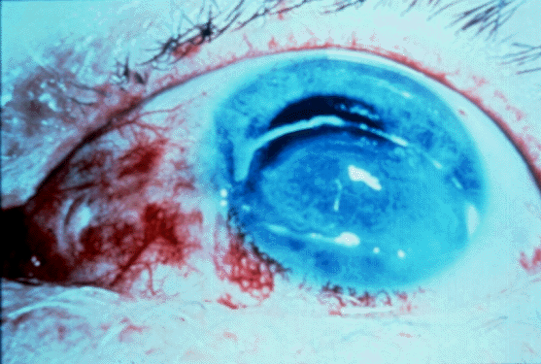
Corneal Damage = Pain
Cornea innervated with many pain nerves
Hurts
Bright side – While Cornea injury has potential to be permanent, there is also potential to heal within 48 hours - depends on amount of energy absorbed.

Slide 60
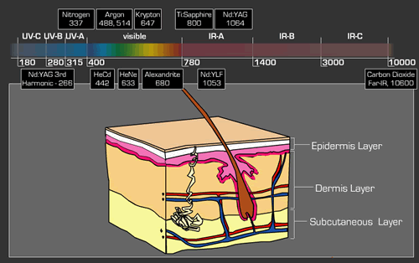
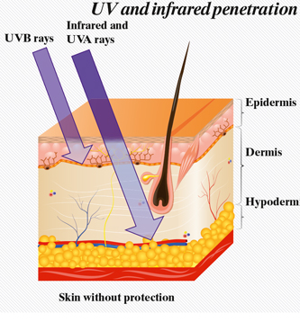
UV and IR Skin Effects
Notes:
Minimal skin reactions to several lasers. Skin is most susceptible to UV and IR wavelengths.

Slide 61
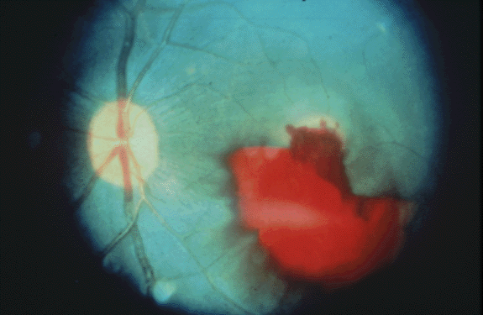
In Case of Incident
If injury suspected, seek immediate medical care without delay - closest to NPS is CHOMP ER
Next,
  Inform your Custodian or supervisor and NPS LSSO (831-656-7568)
  PI and LSSO will report up the rest of the chain of command
LSSO must call Laser Tri-Service Hotline 1-800-473-3549
LSSO will lead a safety investigation

Slide 62
Module Four
Laser Classification, Control Measures, and Accident Summaries

Slide 63
Classes of Lasers
ANSI laser hazard classifications (ANSI Z136.1-2014)
  Class signifies the level of hazard
  Class specifies the extent of safety controls required
ANSI prescribes limits for all types of lasers (wavelength, pulses or CW)
Class 1 === 2 === 3R === 3B ==➔ Class 4
Safe Safe Temp Perm eye injury from
with eye eye diffuse reflections
aversion injury injury Spontaneous fires

Slide 64
Class 1 Lasers
Class 1 denotes lasers and laser systems that do not, under normal operating conditions, pose a hazard.
  Class 1 now includes those lasers that were previously designated as class IIa.

Slide 65
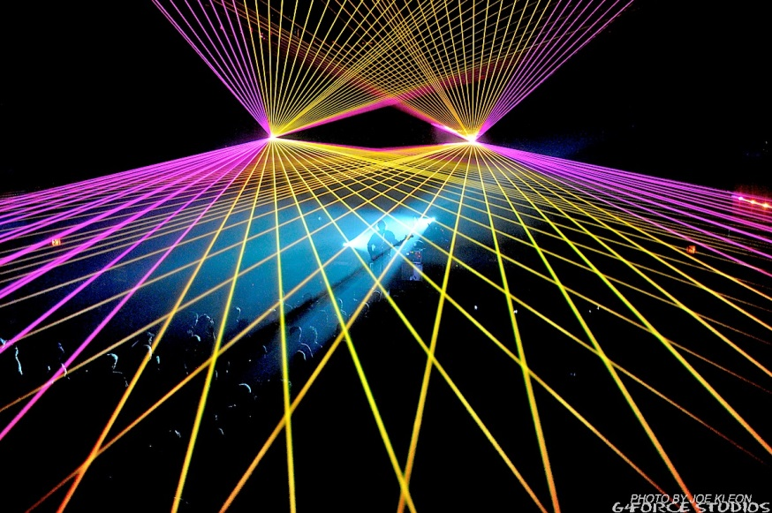
Class 1
Lower power lasers
  Visible light - 1mW or less for small diameter beams
Pulsed or CW
No hazards up to 5-cm optical aids
No safety requirements
May be invisible, or visible
CLASS 1
NO KNOWN HAZARD

Slide 66
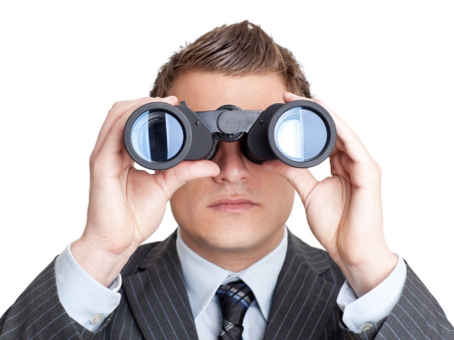
Class 1M
Class 1M denotes class 1 lasers or laser systems that do not normally pose a hazard for unaided viewing but when viewed with magnifying optics (e.g. binoculars, or an eye loupe) can pose a hazard.
Class 1M ======>

Slide 67
Class 2
Class 2 denotes low-power visible lasers which, because of the normal human bright-light aversion response do not normally present a hazard.
  Potential for hazard if viewed directly for extended periods of time.
  A label is required for these lasers warning against staring into the beam.

Slide 68
Class 2
Class 2 lasers are visible (400 to 700-nm wavelength) CW and repetitive-pulse lasers and laser systems which can emit radiant energy exceeding the class 1 AEL.
  For CW less than 7mm diameter, this represents about 2.5 mW/cm^2
  For slow pulsed lasers, pulses in 0.25 seconds cannot exceed approximately 0.25mJ (works out to 1mW average power)
Invisible lasers cannot be class 2.

Slide 69
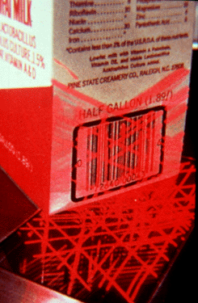
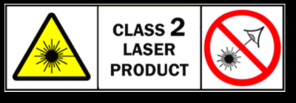
Class 2
Visible ONLY!
Examples are some bar code scanners
Eye safe for 0.25 s
No single-pulsed lasers – why?

Slide 70

Class 2M
Class 2M denotes class 2 lasers or laser systems that do not normally pose a hazard for unaided viewing but with certain optical aids are potentially dangerous.
Class 2M ======>

Slide 71
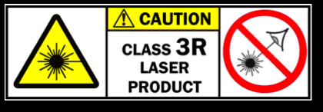
Class 3R
Class 3R can cause temporary eye injury
Reduced (hence the “R”) requirements from higher power Class 3 lasers.
5x Class 1 MPE
  Corresponds to about 5mW for small diameter visible CW lasers
Old class IIIa can be treated as class 3R. This captures some laser pointers.

Slide 72
Class 3B
Class 3B denotes lasers or laser systems that can produce skin or eye injury by intra-beam contact or specular reflection.
Normally, Class 3B lasers do not have a hazardous diffuse reflection.
Old class IIIb are usually Class 3B. Watch for this on many laser pointers -HAZARDOUS and requires controls.

Slide 73
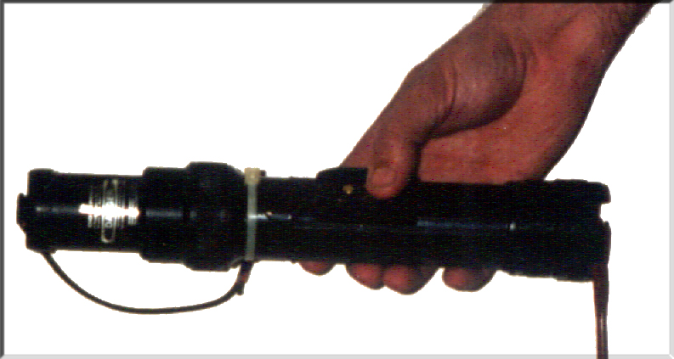
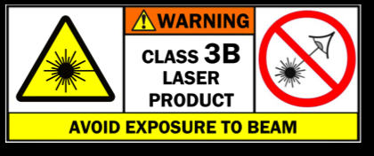
Class 3B
Hazardous for intrabeam viewing under most conditions
Greater than 5 times
  Class 1 for UV, IR lasers
  Class 2 for visible lasers
Up to 500 times Class 1

Slide 74
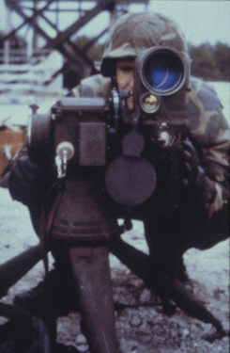
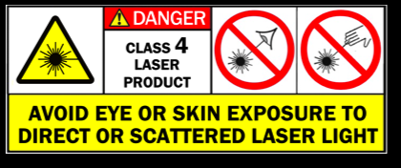
Class 4 Lasers
Class 4 lasers and laser will cause injury by intrabeam contact
Hazardous specular and diffuse reflections
Skin hazards
Spontaneous fire hazard

Slide 75
Embedded Systems
Any class laser that is effectively contained in an interlocked, light tight enclosure effectively becomes a Class 1 Laser System (with an embedded higher class laser).
Laser printers, copiers, CD machines, and many other common items use this approach
No controls are required for the general operation of Class 1 systems. The same can be applied if a higher class system is properly enclosed.
For NPS, if it is feasible to override the enclosure, then a Custodian and Permit shall be assigned. Operators endorsed by the Custodian to operate the system as a Class 1 laser shall not need to be enrolled in the Laser Safety Program.
Collaborate with the LSSO for details

Slide 76
Fiber Optics and Hazard Levels
Optic Fiber Communication Systems (OFCS) Hazard Levels are assigned based on system parameters and accessibility.
    Similar to open laser– Hazard Level 1, 1M, 2, 2M, 3R, 3B, and 4.
    Four types of access – Inaccessible, controlled, restricted, unrestricted.
      A restricted location is not generally accessible to the public, but may be accessible to authorized personnel that may not have laser safety training.
      A controlled location is accessible only to those individuals who have required training in laser safety and servicing and no unauthorized entry.

Slide 77
Fiber Optics and Hazard Levels
  (ANSI Z136.2) OFCS are generally designed as Hazard Level 1 systems with higher power laser energy expected to be contained within the optical fiber(s). There may be risk of exposure above MPE during installation and service, or in the event of a fiber disconnect or break. (Sec. 1.3.2)
    An OFCS is an enclosed laser if it is contained within a protective housing. Opening or removing of the protective housing provides additional access to laser radiation risk above MPE.
      Unterminated fiber
      Break in fiber
    Hazard Level 1 Enclosed Hazard Level 3B. This means that when the OFCS is energized, all fiber connections have been terminated and a secondary cover or jacket has been placed over all fibers.
      This may be operated as a Hazard Level 1 system in a restricted location.
      This may be operated as a Hazard Level 1 system with the covers removed by trained operators in a controlled location.

Slide 78
Policy
It is Navy policy to identify and control laser radiation hazards early during design and development as a matter of military necessity.
It is also the policy of the Navy to ensure that personnel are not exposed to laser radiation in excess of the MPE throughout the life cycle of laser systems, including research, design, testing, development, evaluation, acquisition, deployment, operation, support, maintenance, demilitarization and disposal.

Slide 79
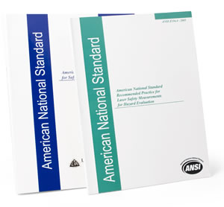
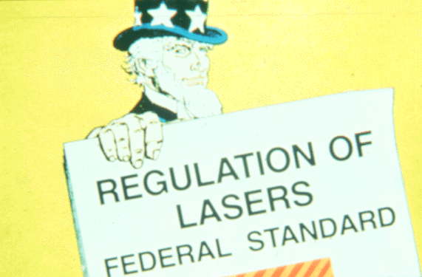
Regulations
NAVPGSCOLINST 5100.27B (2017)
ANSI Z136.1 (Safe Use 2014)
ANSI Z136.5 (Education 2009)
OPNAVINST 5100.27B / MCO 5104.1B (Navy Use 2008)
21 CFR 1040.10 (FDA Certs)
MIL-HDBK-828A Laser Range Safety

Slide 80
Control Measures
Control measures are generally applied along two categories:
  Engineering Controls
  Administrative (Procedural) Controls
The next two slides list types of control measures that are used to control lasers by class.
Note the increasing controls as hazard class increases.

Slide 81
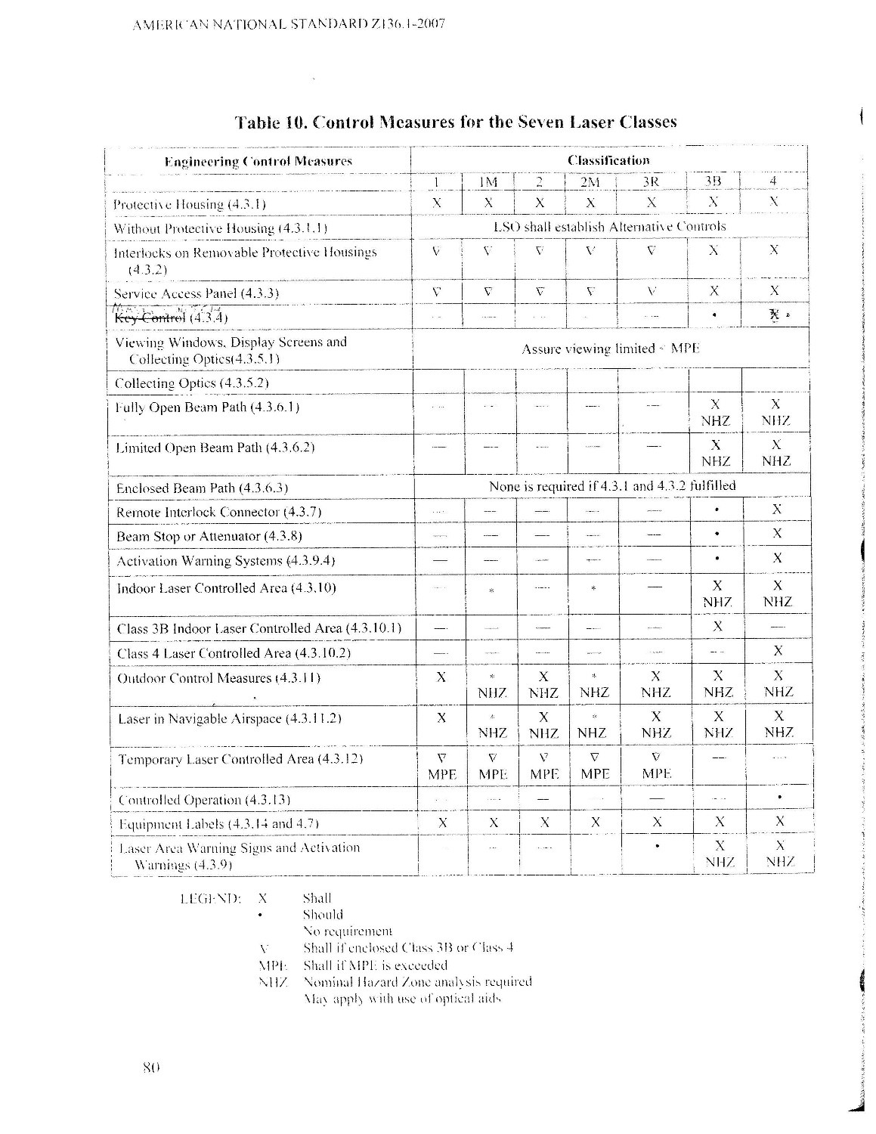
Engineering Controls

Slide 82
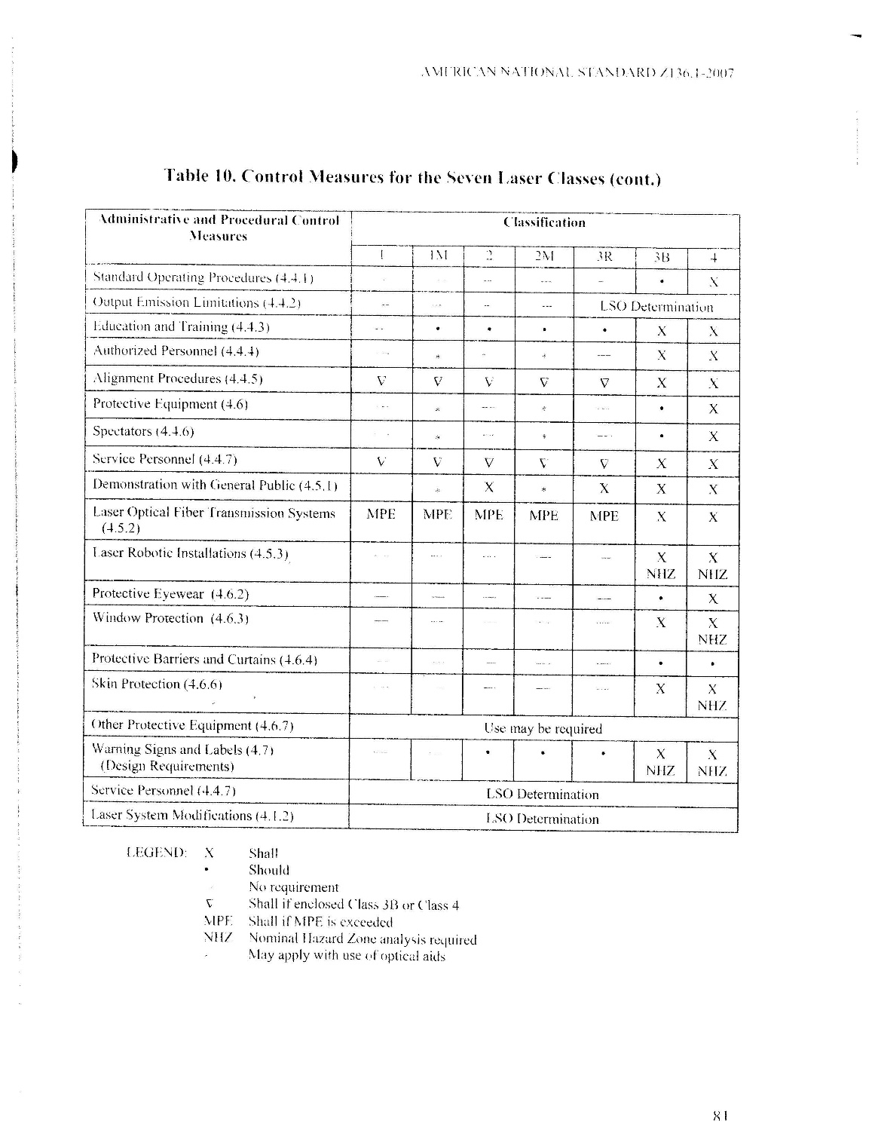
Administrative and Procedural Controls

Slide 83
Laser Accident Summary
Others
Fire
No-Harm Exposure
Malfunction
Electrical
Skin Injury
Eye Injury
0.00%
10.00%
20.00%
30.00%
40.00%
50.00%
60.00%
70.00%
Source: Laser Institute of America, 2008

Slide 84
Laser Accident Causes
Accidental Exposure
Incorrect Eyewear
Improper Service
Ancillary Hazard
High Voltage
Equipment Malfunction
Eye Protection not used
Alignment Procedures
0.00%
5.00%
10.00%
15.00%
20.00%
25.00%
30.00%
Source: Laser Institute of America, 2008

Slide 85
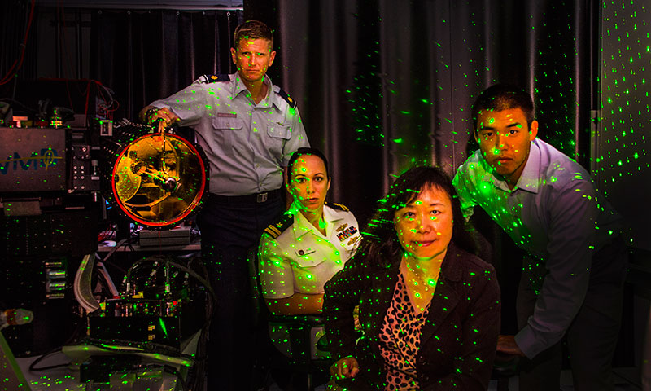
Motherhood: Treat all Lasers Like Loaded Weapons
Don’t aim them at people unless you intend harm...
and don’t look “down the barrel.”
Today@NPS from 7JUN17
“NPS Meteorologist Seeks to Advance Prediction Methods for High Energy Laser Deployment”.
NPS PAO stages photo with a personal Class 3B laser system. Fortunately, no NPS persons were injured.

Slide 86
Module Five
Eye and Skin Protection and Medical Surveillance

Slide 87
Eye Protection
The purpose of protective eyewear is to reduce the intensity of electromagnetic energy to safe levels.
Anytime ocular exposure to laser radiation above MPE is possible, eye protection must be worn.
Eyewear as the principal means of protection from excessive laser radiation shall be selected only when other engineering controls, such as beam enclosure, are not suitable.

Slide 88
Eye Protection
To determine eye protection, we need to know
  wavelength(s) and pulse characteristics
  MPE
  maximum intensity of the beam at the worst feasible positioned eye of an observer
  optical density (OD) required for a filter to reduce that exposure below the MPE.

Slide 89
Eye Protection
MPEs are prescribed in ANSI Z136 standards.
Again, the MPE depends on tissue ability to absorb a specific wavelength, pulse width, pulse repetition frequency, and duration of an exposure.
Optical Density is the characteristic of a protective device to reduce the power or energy of a laser beam at a specific wavelength.

Slide 90

Eye Protection
Optical density is a logarithmic function and is expressed as
$ODrequired= \log_{10}(\frac{Power in (across the area of limiting aperature)}{Power out [Maximum Permissible Exposure]}$)
Optical Density | % of Laser Light Transmitted
1 | 10
2 | 1
3 | 0.1
4 | 0.001
5 | 0.0001

Slide 91
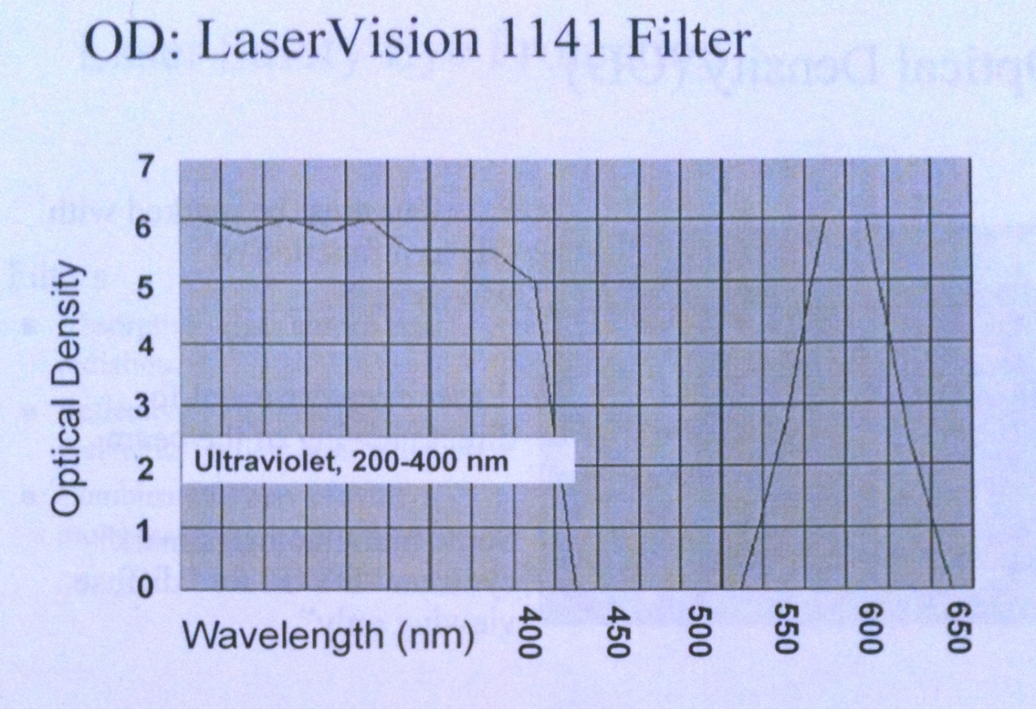
Eyewear OD and Wavelength
This slide illustrates the performance of typical eyewear. Note that it provides OD 5 protection at 400 nm and no protection at all 450 nm. Therefore remember for proper eyewear you must specify:
  OD and
  Wavelength

Slide 92
ODs Required for Optically Aided Viewing
Viewing aids: Binoculars, Eye Loops, Rifle Scopes
Radiant power reaching the retina is increased by the square of the magnifying power of the optical instrument
Radiant power reduced by absorption in the optical system.

Slide 93
ODs Required for Optically Aided Viewing
Hazard from laser exposure can be much greater with optically aided viewing
If a laser beam system must be viewed with a magnifying instrument, significantly higher OD may be required than unaided viewing

Slide 94
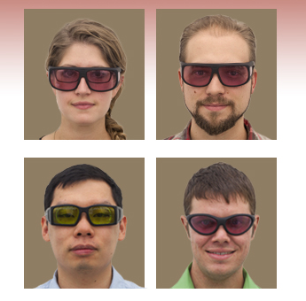
LEP
Generally, LEP should have curved lenses to minimize specular reflections and side shields if the laser can get behind the lens
Eyewear must be approved for the wavelength(s) and optical density of the laser(s) being used
Work with the LSSO before buying!
ANSI approved LEP costs $200-$500 (Kentek, Noir, Laservision) – treat them like gold eggshells

Slide 95
LEP Motherhood
Unworn eyewear does not work
Gaps provide no protection – fit yourself for gaps around nose and periphery
  Light tight not always required, but generally this is desired.
  Consider the hazard and the environment.
Before every laser use:
  check laser wavelength and OD required (this is in the LHA), then
  check LEP OD for that wavelength, then
  Inspect for integrity – cracks, scratches, bubbles, bleaching, etc, then
  put on the LEP. And only then,
  turn the laser on.
When finished, is the laser off? How are you sure of this? Check with a beam card? 2 firebreaks? Have a plan to positively and habitually check for HAZARD OFF before removing LEP.
Do not touch your LEP when laser is on except to shove them further on your face
  BAD habit to lift LEP back if challenged to see something. Find another way (brighter lab, beam cards, cameras)

Slide 96
Problems with LEP
Low luminous transmission
  too dark to see through
Sunbleached eyewear
  darkened by sun
  offers less protection than new eyewear
Physical problems
  scratches & cracks
  melting or other damage from high-powered laser

Slide 97
Problems with LEP
Dye absorption protective devices can be saturated, sometimes before damage occurs, and energy may then “flood” through
Same effect is being discovered for extremely fast pulsed lasers – instantaneous power oversaturates LEP and leaking results.
saturation
threshold
damage
threshold
effective OD
Energy/Power

Slide 98
Problems with LEP
Eyewear can fog up - antifog solutions can be used, but care must be taken to ensure solution does not change or interfere with the OD
Same for cleaning – use the included cleaning materials
Notes:
Pass out bad LEP

Slide 99
Eye Protection Reduction During Visible Beam Alignment
NPS allows “alignment eyewear” on a case by case basis.
ANSI allows the LSSO to approve eyewear that is reduced in Optical Density by 1.4 for the visible wavelength required for alignment, for use during alignment.
This must be specifically prescribed in the system SOP associated with the Custodian’s Permit.

Slide 100
Skin Protection
Often, gloves or clothing will suffice for lasers requiring skin protection
If skin protection is required, eye protection is also most certainly required
Sunscreen sweats and wipes off, so it is not recommended for UV systems
For extremely high-powered lasers, there is no protection available for direct exposure - inaccessibility is the only answer

Slide 101
Who needs Medical Surveillance
Personnel who are at risk to an overexposure. This is interpreted by the Navy as those who work with class 3B and 4 lasers.
  Incidental personnel not required to have medical surveillance
    Do not work in laser environment on continuing basis
    Security, custodial, visiting personnel
  Class 1, 2 and 3R lasers operators don’t require surveillance
  Required for Government Laser Maintenance personnel, requested for Contractor Laser Maintenance personnel
  LSSO decision as to exactly who participates, but at NPS by Instruction, ALL Class 3B and 4 Designated Laser Custodians and Designated Laser Workers

Slide 102
Why Medical Monitoring?
Identify pre-existing problems
Detect development of physiological problems
Document overexposure effects
Provide medical history
Protect the worker
Required by BUMEDINST 6470.23

Slide 103
Medical Surveillance
Baseline: prior to first use of a class 3B or 4 laser at NPS
Incident: Over-exposure/mishap
Exit: when finished with NPS Class 3B and 4 lasers (always a challenge)
Periodic exams not required
You must have an eye exam:
Prior to first use of Class 3B or 4 lasers at NPS
After last use of Class 3B or 4 lasers at NPS

Slide 104
NPS Med Exam Scheduling
For Baseline and Exit Exams (plan 30 days):
Get the 5100/1form from the LSSO – fill out the top 10 lines
LSSO will email the Referral Form to the Presidio Health Clinic scheduler Thu Degroot at thu.v.degroot.civ@mail.mil. Backup: Flora Delapena, flora.r.delapena.civ@mail.mil.
You will then call her at 831-242-5332 to schedule. Backup: Flora Delapena at 831-242-4842,
Follow through and arrive on time to complete your exam.
The clinic should give you a copy of the 5100/1 with the doctors signature upon completing this exam. Keep this for your records. If NPS doesn’t get a receipt from the clinic, the LSSO may ask you for a copy to prove completion.
If a Laser Incident Occurs (immediately):
If injury suspected, call (9)911 for the Emergency Room nearest. For NPS it will be CHOMP. Expect to be referred immediately to an ophthalmologist.
Notify the LSSO (sagiles@nps.edu, 831-656-7568, Ha285). LSSO will notify HRO, Presidio of Monterey Health Clinic, and several others.

Slide 105
Module Six
Laser Authorization and Approval, Lab and Range Requirements

Slide 106
Authorization
Laser authorization is handled in two stages
  Stage 1 – Acquisition
  Stage 2 - Permitting

Slide 107
Acquisition
Laser system purchases are approved by the NPS Laser Systems Safety Officer - KFS
  Lasers have their own purchase code.
  KFS has excellent visibility - (KO, Specialists, Finance, Purchasers, Safety)
“Gifts” should be checked with LSSO.

Slide 108
Permiting
Permit
  Assigns a Custodian and identifies Workers
  Tracks inventory at least annually
  Documents LHA, ORM, SOP, Site inventory for Authorized Lasers
All Class 3B and Class 4 lasers require a Permit for inventory and use.
LSSO maintains campus wide inventory and Authorization list
A Permit updates for inventory, personnel, site, or authorization changes.

Slide 109
Laser Logs
A Log of use for each system Authorized on a Permit.
  Record annual system specific training for all users (review of LHA, ORM, SOP, manufacturer’s user guidance)
  Record daily use
  Record maintenance events
  Any other historically desirable data (performance, stability, etc)

Slide 110
Laser Hazard Analysis
(LHA)
Class 3B and 4 systems require an LHA for each frequency, power, site, operational environment, or other critical parameters. There could be many.
Collaborative effort between the LSSO and Custodian.
Often done by software.
Possible to do freehand. May be necessary to do freehand for complex cases.

Slide 111
Operational Risk Management (ORM)
Class 3B and 4 systems require deliberate ORM.
Once LHA completed, the hazards inform the 1st step of the ORM.
  Identify the hazards – from LHA
  Assess the hazards
  Make Risk Decisions – Eliminate exposure above MPE…
  Implement Controls – SOP, Permits
  Supervise – SOP, Laser Log, Permits
Collaborative effort between the LSSO and Custodian.
There’s a template for the laser ORM available online.

Slide 112
Standard Operating
Procedures (SOP)
Required for Class 3B and Class 4 open beam laser systems
Required for Class 1M, 2M, 3R use outdoors
Alignments must be specifically addressed
Incorporates the elements of the ORM
There’s a template that covers most structures for NPS available online.

Slide 113
Outdoor Laser Use
AKA Range Operations
Outdoor laser use is substantially more involved than using lasers in the confines of an enclosed laboratory
Outside of combat, some class 2M, 3R and all Class 3B and 4 lasers can only be used outdoors on a certified laser range.
Should you need to use lasers outdoors, early coordination with the LSSO and target site RSO is recommended.
LSRB review may be required for new systems or applications
What’s the LSRB?
The LSRB is the “Big Navy” Laser Safety Review Board in Dahlgren, VA. A brief and endorsement is required for outdoor operations above certain thresholds.

Slide 114
Range Certification
A Certifying Official (RLSS) must conduct a hazard survey and site evaluation
  All new laser ranges
  Whenever changes to an established range will exceed the current certification limits
  Every three years
Range certifications are often restrictive. This is usually caused by
  The range is small compared to the system NOHD and bordered by unrestricted land
  Poor communications of LHA, ORM, and proposed SOP.
  Poor understanding of mission (FSO, Metoc, LIDAR)
The Certification will identify firing points, firing fans, run-in headings, laser target areas, tactics, buffer angles, range clearing, range safe, EPs, etc.

Slide 115
Requirements:
New Laser at NPS
Meet the General Laser Lab Safety Requirements
  Prior to First Use
    NPS Initial Laser Safety Training, and pass the quiz 75% or better
    Baseline Medical Exam Completed (2020: exception possible if unavailable)
    Laser(s) Permitted to a Custodian and approved for use by the NPS LSSO
      Hazard Analysis and NOHD/NHZ defined
      ORM Assessment completed
      SOP approved by the LSSO
      Site Inspections
Annual System Specific training is required for all Custodians and Workers on all Class 3B and Class 4 systems – document in the Laser Log. This includes new laser systams.
Now, go ahead and operate the laser system IAW the SOP.

Slide 116
Contact Info
This marks the end of the training.
Please review as necessary and take the Laser Safety Quiz on Sakai
Scott Giles
NPS Laser System Safety Officer (LSSO)
sagiles@nps.edu
W: 831-656-7568
Eye Exam Scheduling
Fill out the SECNAV 5100/1 Medical Referral Form (online at NPS Lasers) and provide to LSSO
Contact Presidio Health Clinic scheduler Thu Vo at thu.v.degroot.civ@mail.mil.

